Slide 1
ICD-10 Preparation at
Virginia Hospital Center
HealthTechNet
July 19, 2013

Slide 2
Agenda
Introduction to ICD-10
Timeline
Readiness Assessment
Departments and Systems Impacted
Steering Committee
Education

Slide 3
What’s New in ICD-10?
ICD-9
ICD-10
3-5 Characters in Length
16,000 Codes
Limited space for adding new codes
Lacks details
Based on outdated technology
3-7 Characters in Length
140,600 Codes
Flexible for adding new codes
Very Specific
Reflects current usage of medical terminology and devices
Reference: AHA Supplement, researched by Lee Ann Runy

Slide 4
VHC’s ICD-10 Timeline
2011
- Introduction and Education
- Research Assessment Vendors
- Project Planning
2012
-Implement Billing Regulatory Updates (EDI 5010)
- Complete Readiness Assessment
- Coder Anatomy and Physiology Education
- Define Project Charter / Statement of Work
2013
- Stand-up Steering Committee
- Intensive Coder Education
- Perform System Upgrades as needed
- Develop / Deploy Test Scripts
2014
- Educate Hospital Staff and Physicians
- Ongoing Coder Education
- Integrated Testing
- Live: October 1st
- Post-Live Monitoring

Slide 5
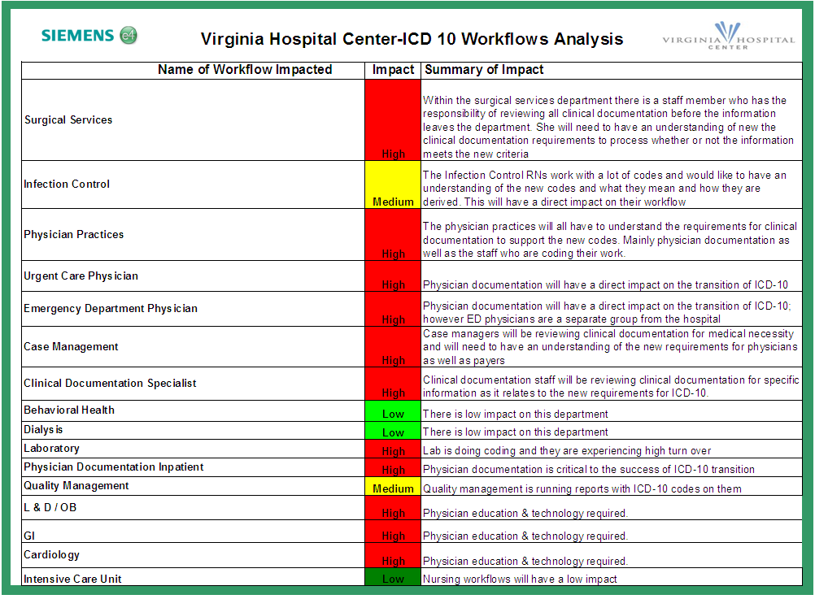

Slide 6
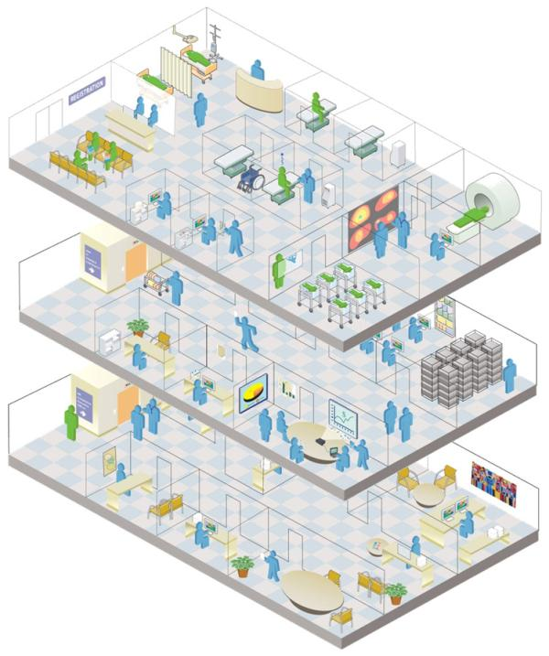
ICD-10 Impacts the Entire Hospital Community
Patient Access
Nurses
Case Managers
Physicians
Quality Assurance
Utilization Review
Claims Review
Finance/Patient Financial Services
Contract Management
IT/IS
Senior Management
Human Resources
Compliance
HIM Staff (MTs, CTRs, and other HIM Staff)
HIM and Coding Managers
Auditors
Outpatient Coders
Inpatient Coders
Source: Precyse Solutions

Slide 7
ICD-10 Impacts Many VHC Systems
Any hospital system, extract or report that uses ICD codes will be affected, including…
Soarian Financials & Soarian Clinicals
3M (HIM)
Empower (ED)
Crimson (QRM & HIM)
Sunquest (Lab)
Centricity (Radiology)
Emdeon (Claims Submission)
InterQual (QRM)
Midas+ (QRM)
Picis (OR)
Trendstar & StrataJazz (Accounting)

Slide 8
Steering Committee Provides Oversight
Who?
  Leaders and Key Stakeholders impacted by ICD-10
What?
  Provides resources and planning as needed to ensure project success
  Resolves critical issues and changes in scope including major milestones
  Sounding board for decisions and actions that affect user acceptance of the project
  Reviews decisions, recommendations and requests that are high in integration and complexity
When?
  February 2013 through December 2014
  Bi-monthly, then transition to monthly

Slide 9
Coder Education Intensive
VHC Coders began ICD-10 in April 2013
Training consists of 29 hours of boot camp style over 5 days
  12 hours for Diagnosis Training
  17 hours for Procedure Training
3 sessions / 7 Coders in each session

